Slide 1
Sales DashBoard 2019
KATRAVATH RAJENDAR

Slide 2
Agenda :
Objectives :
Problem statement
Sales and product description
Columns description in sales data analysis
Insights
conclusion

Slide 3
Sales DashBoard 2019
Problem statement:
Analyze sales data to identify trends, top-selling products, and revenue metrics for business decision-making.

Slide 4
Sales and products description :
The sales completely happend at united states of america. In different cities like Atlanta,Austin,Bostan,Dallas,Los Angles,Sanfransico,new york city,potland and seattle.
The product saled like 20 in monitor, 27in 4k gaming monitor,27 in FHD Monitor,34 in ultra Wide monitor, AA Battries (4-pack), AAA Battries (4-pack), Apple Airpods Headphones,Boss soundphones Headphones,Flatscreen TV,Google phone, Iphone,LG Dryer,LG waching Machine, Lightening charging cable,Mackbook pro laptop,Tinkpad laptop,USB-c charging cable,Vareebad Phone,wired headphones.

Slide 5
Columns description for sales data analysis:
COLUMN DESCRIPTION FOR SALES DATA ANALYSIS:
• ORDER ID
• PRODUCT
• QUANTITY ORDERED
• PRICE EACH
• ORDER DATE
• PURCHASE ADDRESS
• MONTH
• SALES
• CITY
• HOUR

Slide 6
Insights from Atlanta city
Sales trend over time using the line chart:
In december sales of all products in the Altanta city is high that is 4613.44k where compare to the other months
In january the sales are less that is 1822.26k

Slide 7
Top 5 Best selling proudcts counting through tree map in Atlanta city
Finding the top five product sales count through the tree map:
USB-C charging cable product sale count is 21.90K
Lingtening charging cable product sale count is 21.66k
AAA Battries (4-pack) product sales count is 20.64k
AA Battries (4-pack) product sale count is 20.58k
Wired headphones product sales count is 18.88

Slide 8
Top 5 best selling products of Atlanta city:
AAA battries (4-pack) product
AA battries (4-pack) prouct
USB-c charging cable product
Lightening charging cable product
Wired Headphones product

Slide 9
Insights from the weekly sales distribution by weekday of Atlanta city :
In Tuesday only the slaes distribution is high that is 27.2k when compare to other days slaes distribution.
Sunday sales distribution is 26.6k and it is in the second position in sales distibution.
monday,Wednesday,thursday and saturday has common sales distribution
That is 26.5k.
Friday sales distribution is less when compare to other sales distribution days that is 26.2k

Slide 10
Finding the revenue metrics Atlanta city :
The revenue metrics that are :
1.Total profit: Sum up the net profit from all sales transactions.
2. Sales quantity: Calculate the total number of units sold.
3. Profit margin: Compute the ratio of net profit to total revenue, usually expressed as a percentage.
The total revenue of Atlanta city is 14.881k
The sales quanity of Atlanata city is 17k
The profit margin of atlanata city is 55.77%

Slide 11
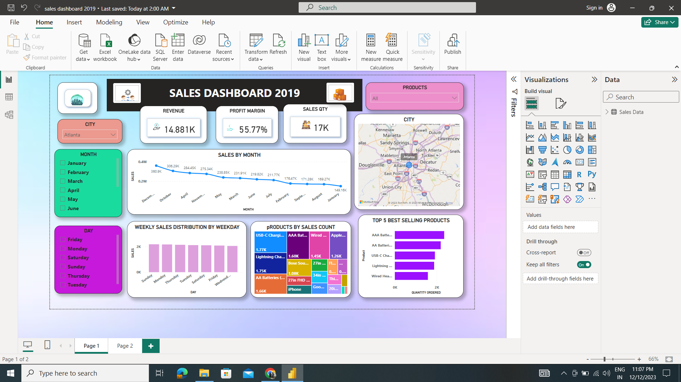
Dashboard of Atlanta city :

Slide 12
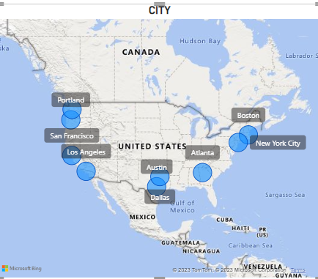
Cities by sales using the map

Slide 13
Insights from Austin city :
Sales trend over time using the line chart:
The highest sales happened in the december month that is 4613.44k
The lowest sales happened in the january month that is 1822.36k

Slide 14
Best top 5 selling products using the tree map in Austin city:
Finding the top five product sales count through the tree map:
USB-C charging cable product sale count is 21.91K
Lingtening charging cable product sale count is 21.66k
AAA Battries (4-pack) product sales count is 20.64k
AA Battries (4-pack) product sale count is 20.58k
Wired headphones product sales count is 18.88

Slide 15
Top 5 best selling product in Austin city :
The best top five selling product in the Austin city 2019 is :
AAA Battries (4-pack) selling product
AA Battries (4-pack) selling product
USB-C charging cable selling product
Lightening charging cable selling product
WiredHeadphones selling prodcut

Slide 16
Weekly sales distribution by weekday using in Austin city :
Insights from the weekly sales distribution by weekday using:
On thursday the sales distribution is high that is 27.2k
Sunday the sales distribution is 26.6k
Monday saturday,wednesday and Thursday the sales distribution is 26.5k
Friday the sales distribution is 26.2k

Slide 17
Finding the revenue metrics in Austin city :
The revenue metrics that are :
1.Total profit: Sum up the net profit from all sales transactions.
2. Sales quantity: Calculate the total number of units sold.
3. Profit margin: Compute the ratio of net profit to total revenue, usually expressed as a percentage.
Total profit(Revenue) in Austin city is 9.905k
Sales quantity is in Austin city is 11k
Profit margin in Austin city is 53.35%

Slide 18
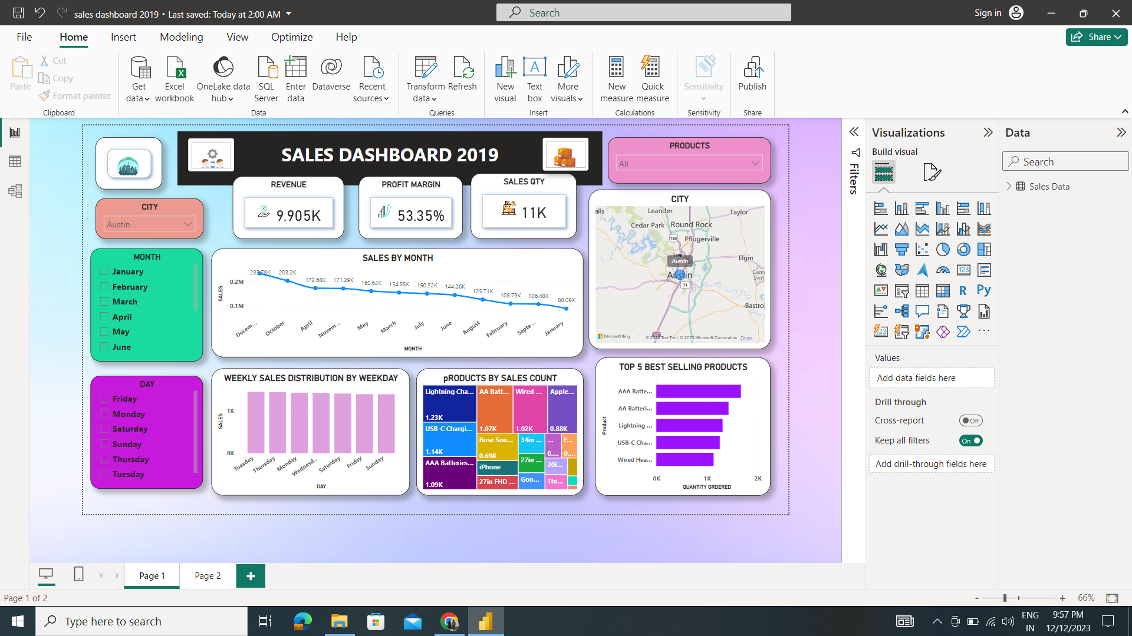
Dashboard of Austin city:

Slide 19
Finding the insights from the Boston city :
Sales trend over time using the line chart:
December has the highest sales trend that is 4613.44k
January has the least slaes trend that is 1822.26k

Slide 20
Best top 5 selling products counting using the tree map
USB-C charging cable product selling count is 21.90k
Lightening charging cable product selling count is 21.66k
AAA Battries (4-pack) product selling count is 20.64k
AA Battries (4-pack) product selling count is 20.58k
Wired Headphones product selling count is 18.88k

Slide 21
Top 5 best selling products in bostan city :
The best top five selling product in the Austin city 2019 is :
AAA Battries (4-pack) selling product
AA Battries (4-pack) selling product
USB-C charging cable selling product
Lightening charging cable selling product
WiredHeadphones selling prodcut

Slide 22
Weekly sales distribution by weekday using in Bostan city:
Insights from the weekly sales distribution by weekday using:
On thusday,sunday and monday the sales distribution is high that is 27k
Monday saturday,wednesday and Thursday and friday the sales distribution is 26k

Slide 23
Finding the revenue metrics in Bostan city:
The revenue metrics that are :
1.Total profit: Sum up the net profit from all sales transactions.
2. Sales quantity: Calculate the total number of units sold.
3. Profit margin: Compute the ratio of net profit to total revenue, usually expressed as a percentage.
Total profit(Revenue) in Bostan city is 19.934k
Sales quantity is in Bostan city is 23k
Profit margin in Bostan city is 66.18%

Slide 24
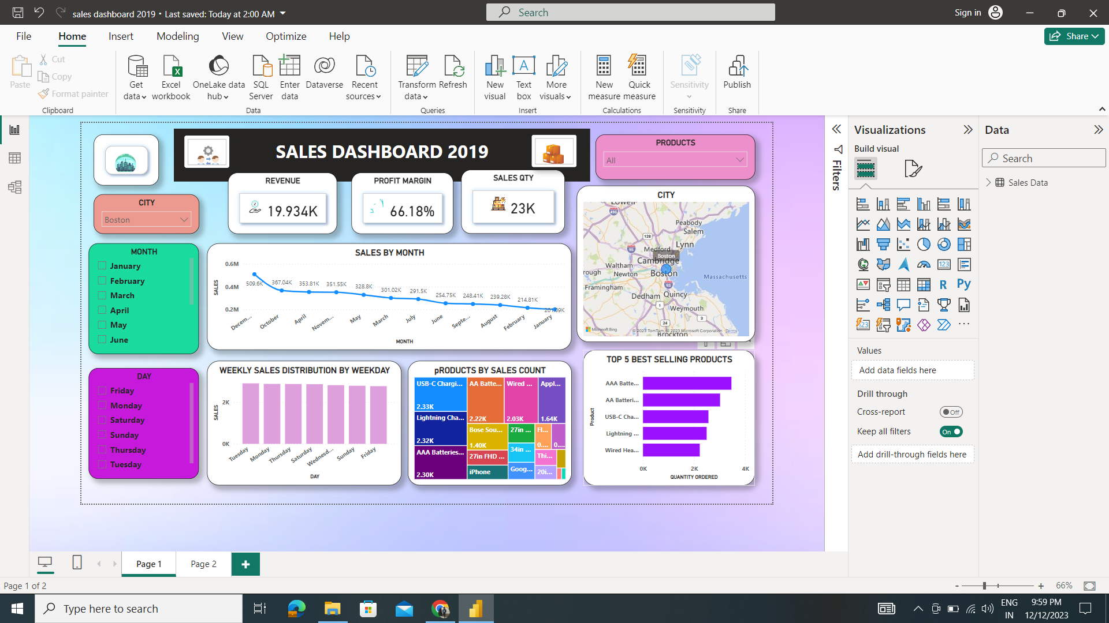
Dashboard of Bostan city :

Slide 25
Finding the insights from the Dallos city :
Sales trend over time using the line chart :
December has the highest sales trend that is 4613.44k
January has the least slaes trend that is 1822.26k

Slide 26
Best top 5 selling products counting using the tree map in Dallas city :
USB-C charging cable product selling count is 21.90k
Lightening charging cable product selling count is 21.66k
AAA Battries (4-pack) product selling count is 20.64k
AA Battries (4-pack) product selling count is 20.58k
Wired Headphones product selling count is 18.88k

Slide 27
Top 5 best selling products in the dallas city :
The best top five selling product in the dallas city 2019 is :
AAA Battries (4-pack) selling product
AA Battries (4-pack) selling product
USB-C charging cable selling product
Lightening charging cable selling product
WiredHeadphones selling prodcut

Slide 28
Weekly sales distribution by weekday using in dallas city :
Insights from the weekly sales distribution by weekday using:
On thusday the sales distribution is high that is 27.2k
Sunday the sales distribution is 26.6k
Monday, saturday,wednesday and thursday the sales distribution is 26.5k
friday the sales distribution is 26.2k

Slide 29
Finding the revenue metrics in Dallas city :
The revenue metrics that are :
1.Total profit: Sum up the net profit from all sales transactions.
2. Sales quantity: Calculate the total number of units sold.
3. Profit margin: Compute the ratio of net profit to total revenue, usually expressed as a percentage.
Total profit(Revenue) in dallas city is 14.82k
Sales quantity is in dallas city is 17k
Profit margin in dallas city is 54.45%

Slide 30
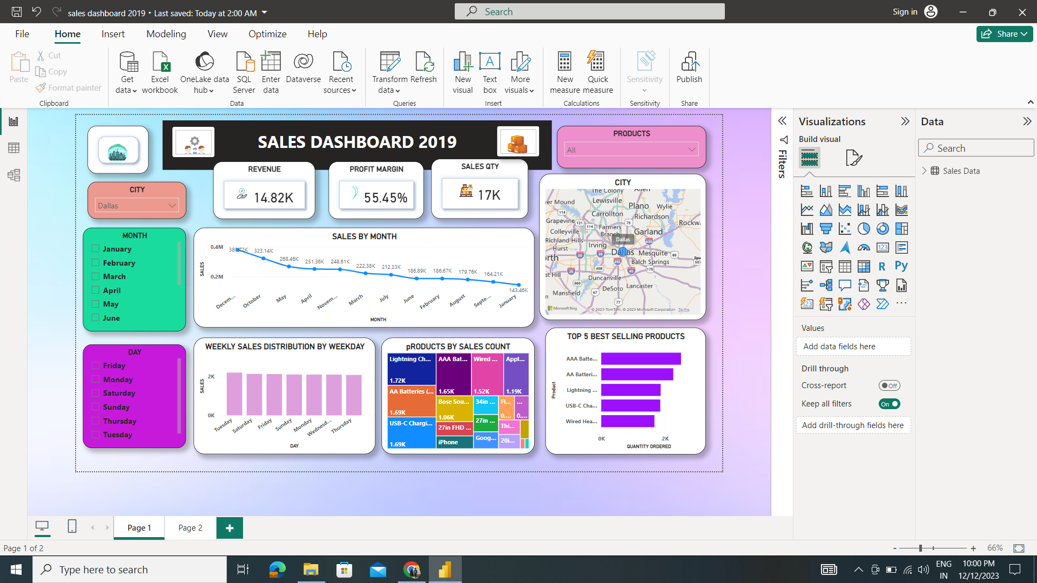
Dashboard of Dallas city :

Slide 31
Insights from the los Angles city :
Sales trend over time using the line chart :
December has the highest sales trend that is 4613.44k
January has the least slaes trend that is 1822.26k

Slide 32
Best Top 5 selling products using the tree map in Los Angles city:
USB-C charging cable product selling count is 21.90k
Lightening charging cable product selling count is 21.66k
AAA Battries (4-pack) product selling count is 20.64k
AA Battries (4-pack) product selling count is 20.58k
Wired Headphones product selling count is 18.88k

Slide 33
Weekly sales distribution by weekday using in Los Angles city :
Insights from the weekly sales distribution by weekday using:
On thusday sunday and monday the sales distribution is high that is 27k
Saturday,wednesday, friday and thursday the sales distribution is 26k

Slide 34
Finding the revenue metrics in Los angles city :
The revenue metrics that are :
1.Total profit: Sum up the net profit from all sales transactions.
2. Sales quantity: Calculate the total number of units sold.
3. Profit margin: Compute the ratio of net profit to total revenue, usually expressed as a percentage.
Total profit(Revenue) in los Angles city is 29.605k
Sales quantity is in los Angles city is 33k
Profit margin in los angles city is 57.10%

Slide 35
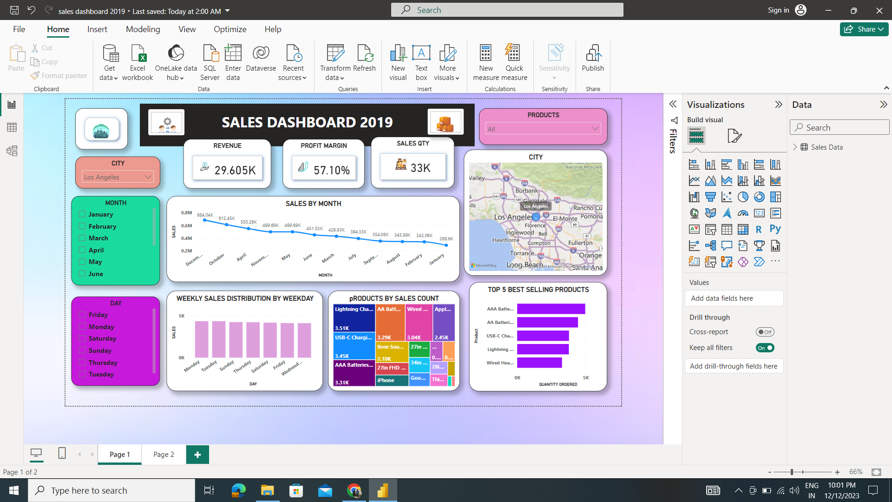
Dashboard of Los Angles city :

Slide 36
Finding the insights from the new york city
Sales trend over time using the line chart:
December has the highest sales trend that is 4613.44k
January has the least slaes trend that is 1822.26k

Slide 37
Best top 5 selling products counting using the tree map:
USB-C charging cable product selling count is 21.90k
Lightening charging cable product selling count is 21.66k
AAA Battries (4-pack) product selling count is 20.64k
AA Battries (4-pack) product selling count is 20.58k
Wired Headphones product selling count is 18.88k

Slide 38
Weekly sales distribution by weekday using in new york city :
Insights from the weekly sales distribution by weekday using:
On thusday the sales distribution is high that is 27.2k
Sunday the sales distribution is 26.6k
Monday, saturday,wednesday,thursday the sales distribution is 26.5k
Friday the sales distribution is 26.2k

Slide 39
Top 5 best selling products in new york city :
The best top five selling product in the new york city 2019 is :
AAA Battries (4-pack) selling product
AA Battries (4-pack) selling product
USB-C charging cable selling product
Lightening charging cable selling product
WiredHeadphones selling prodcut

Slide 40
Finding the revenue metrics in new York city :
The revenue metrics that are :
1.Total profit: Sum up the net profit from all sales transactions.
2. Sales quantity: Calculate the total number of units sold.
3. Profit margin: Compute the ratio of net profit to total revenue, usually expressed as a percentage.
Total profit(Revenue) in new york city is 24.876k
Sales quantity in new york city is 28k
Profit margin in new york city is 62.06%

Slide 41
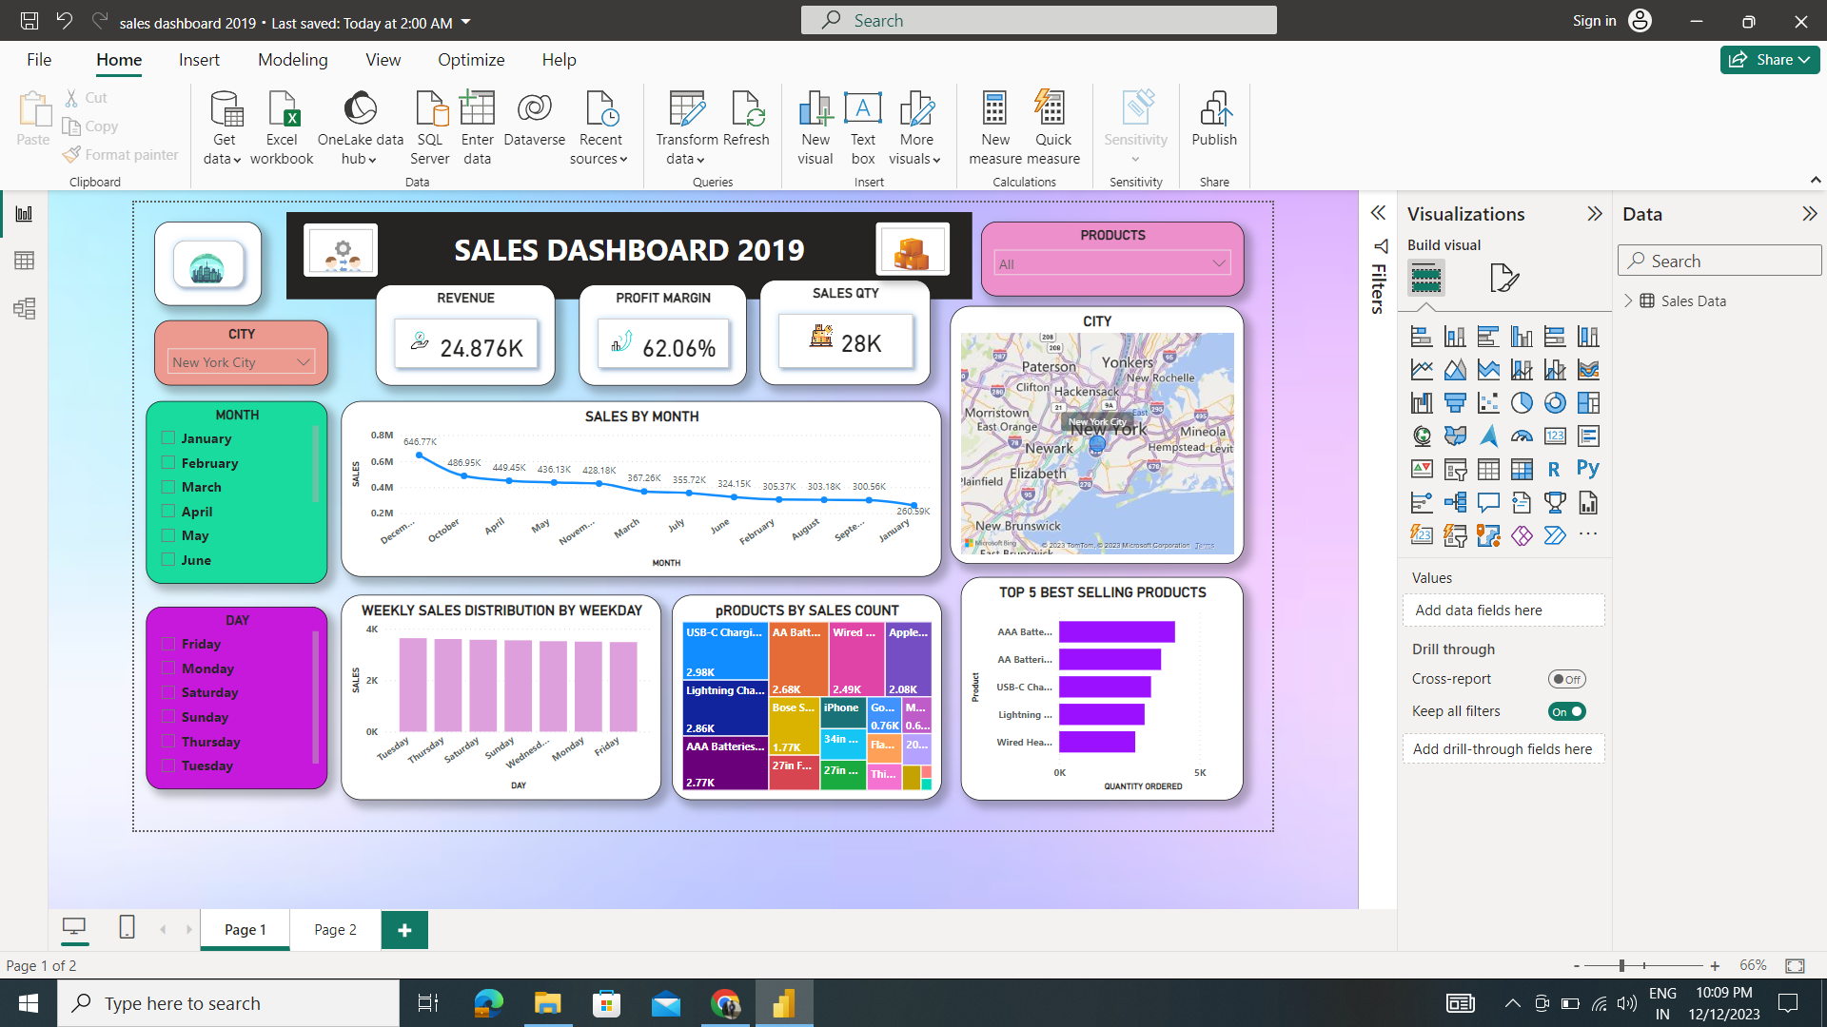
Dashboard of new york city :

Slide 42
Finding insights from the portland city :
Sales trend over time using the line chart :
December has the highest sales trend that is 4613.44k
January has the least slaes trend that is 1822.26k

Slide 43
Best top 5 selling products counting by using the tree map in portland city:
USB-C charging cable product selling count is 21.90k
Lightening charging cable product selling count is 21.66k
AAA Battries (4-pack) product selling count is 20.64k
AA Battries (4-pack) product selling count is 20.58k
Wired Headphones product selling count is 18.88k

Slide 44
Weekly sales distribution by weekday using in portland city :
Insights from the weekly sales distribution by weekday using:
On thusdaythe sales distribution is high that is 27.2k
Sunday the sales distribution is 26.6k
Monday, saturday,wednesday,thursday the sales distribution is 26.5k
Friday the sales distribution is 26.2k

Slide 45
Top 5 best selling products in portland city :
The best top five selling product in the doutsn city 2019 is :
AAA Battries (4-pack) selling product
AA Battries (4-pack) selling product
USB-C charging cable selling product
Lightening charging cable selling product
WiredHeadphones selling prodcut

Slide 46
Finding the revenue metrics in portland city :
The revenue metrics that are :
1.Total profit: Sum up the net profit from all sales transactions.
2. Sales quantity: Calculate the total number of units sold.
3. Profit margin: Compute the ratio of net profit to total revenue, usually expressed as a percentage.
Total profit(Revenue) in portland city is 12.465k
Sales quantity in portland city is 14k
Profit margin in portland city is 54.92%

Slide 47
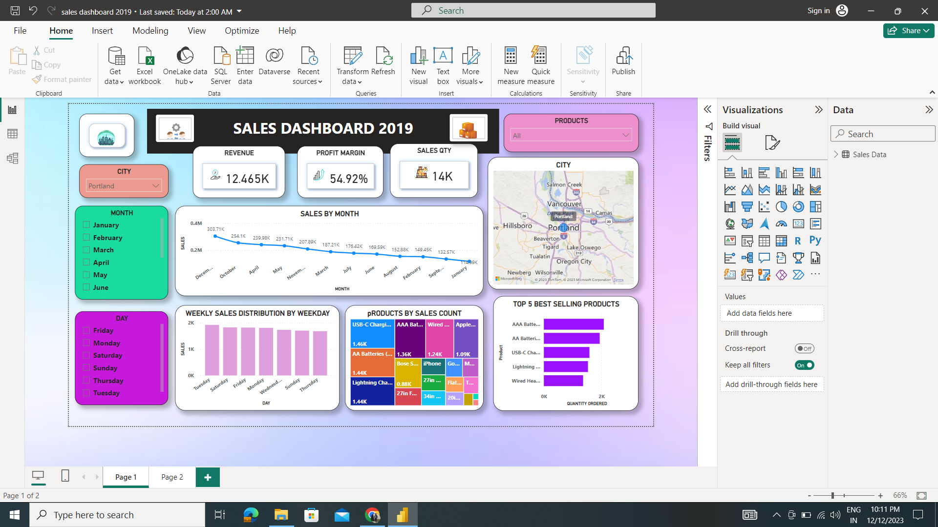
Dashboard of portland city :

Slide 48
Finding the insights from the san fransisco city :
Sales trend over time using the line chart :
December has the highest sales trend that is 4613.44k
January has the least sales trend that is 1822.26k

Slide 49
Best selling top 5 products using the tree map in sanfrancisco city :
USB-C charging cable product selling count is 21.90k
Lightening charging cable product selling count is 21.66k
AAA Battries (4-pack) product selling count is 20.64k
AA Battries (4-pack) product selling count is 20.58k
Wired Headphones product selling count is 18.88k

Slide 50
Weekly sales distribution by using weekday in sanfranciso city :
Insights from the weekly sales distribution by weekday using:
On thusday the sales distribution is high that is 27.2k
Sunday the sales distribution is 26.6k
Monday, saturday,wednesday,thursday the sales distribution is 26.5k
Friday the sales distribution is 26.2k

Slide 51
Top 5 best selling products in snafranciso city :
The best top five selling product in the sanfrancisco city 2019 is :
AAA Battries (4-pack) selling product
AA Battries (4-pack) selling product
USB-C charging cable selling product
Lightening charging cable selling product
WiredHeadphones selling prodcut

Slide 52
Finding the revenue metrics of sanfranciso city :
The revenue metrics that are :
1.Total profit: Sum up the net profit from all sales transactions.
2. Sales quantity: Calculate the total number of units sold.
3. Profit margin: Compute the ratio of net profit to total revenue, usually expressed as a percentage.
Total profit(Revenue) in sanfransisco city is 44.732k
Sales quantity in sanfrancisco city is 50k
Profit margin in sanfrancisco city is 61.41%

Slide 53
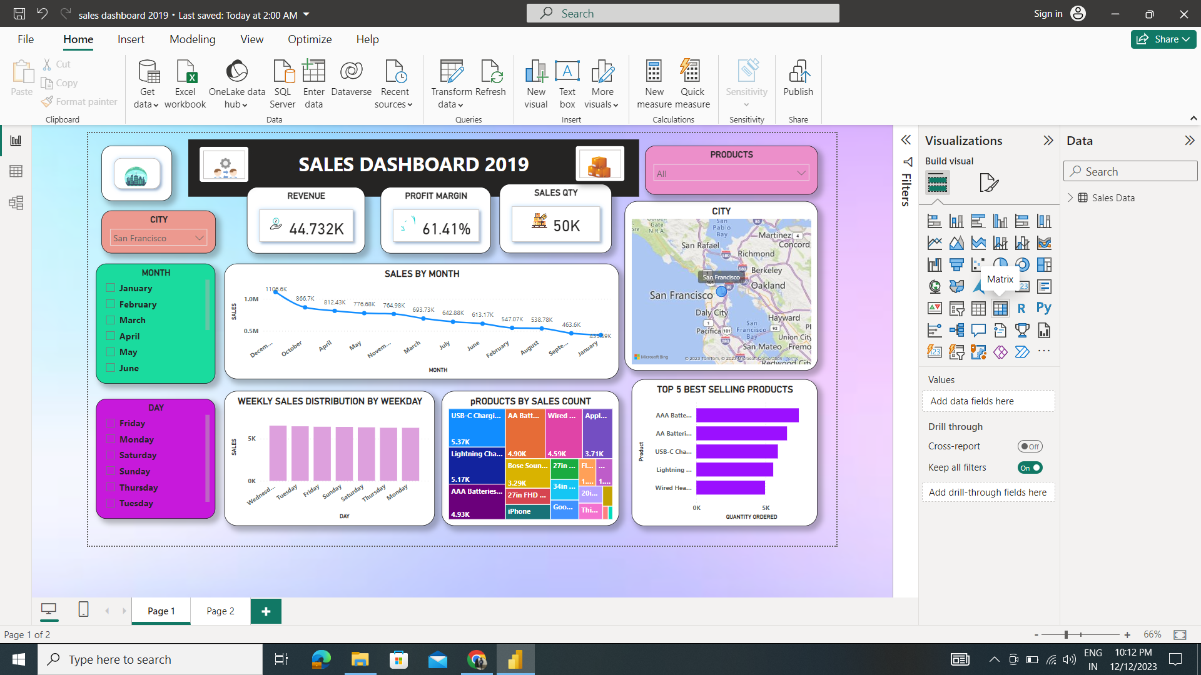
Dashboard of sanfrancisco city :

Slide 54
Finding insights from the seattle city :
Sales trend over time using the line chart:
December has the highest sales trend that is 4613.44k
January has the least sales trend that is 1822.26k

Slide 55
Best top 5 products selling count using the tree map in seattle city:
USB-C charging cable product selling count is 21.90k
Lightening charging cable product selling count is 21.66k
AAA Battries (4-pack) product selling count is 20.64k
AA Battries (4-pack) product selling count is 20.58k
Wired Headphones product selling count is 18.88k

Slide 56
Weekly sales distribution by using weekday in seattle city :
Insights from the weekly sales distribution by weekday using:
On thusday the sales distribution is high that is 27.2k
Sunday the sales distribution is 26.6k
Monday, saturday,wednesday,thursday the sales distribution is 26.5k
Friday the sales distribution is 26.2k

Slide 57
Top 5 best selling products in seattle city :
The best top five selling product in the seattle city 2019 is :
AAA Battries (4-pack) selling product
AA Battries (4-pack) selling product
USB-C charging cable selling product
Lightening charging cable selling product
WiredHeadphones selling prodcut

Slide 58
Finding the revenue metrics of seattle city :
The revenue metrics that are :
1.Total profit: Sum up the net profit from all sales transactions.
2. Sales quantity: Calculate the total number of units sold.
3. Profit margin: Compute the ratio of net profit to total revenue, usually expressed as a percentage.
Total profit(Revenue) in seattle city is 14.732k
Sales quantity in seattle city is 17k
Profit margin in seattle city 52.62%

Slide 59
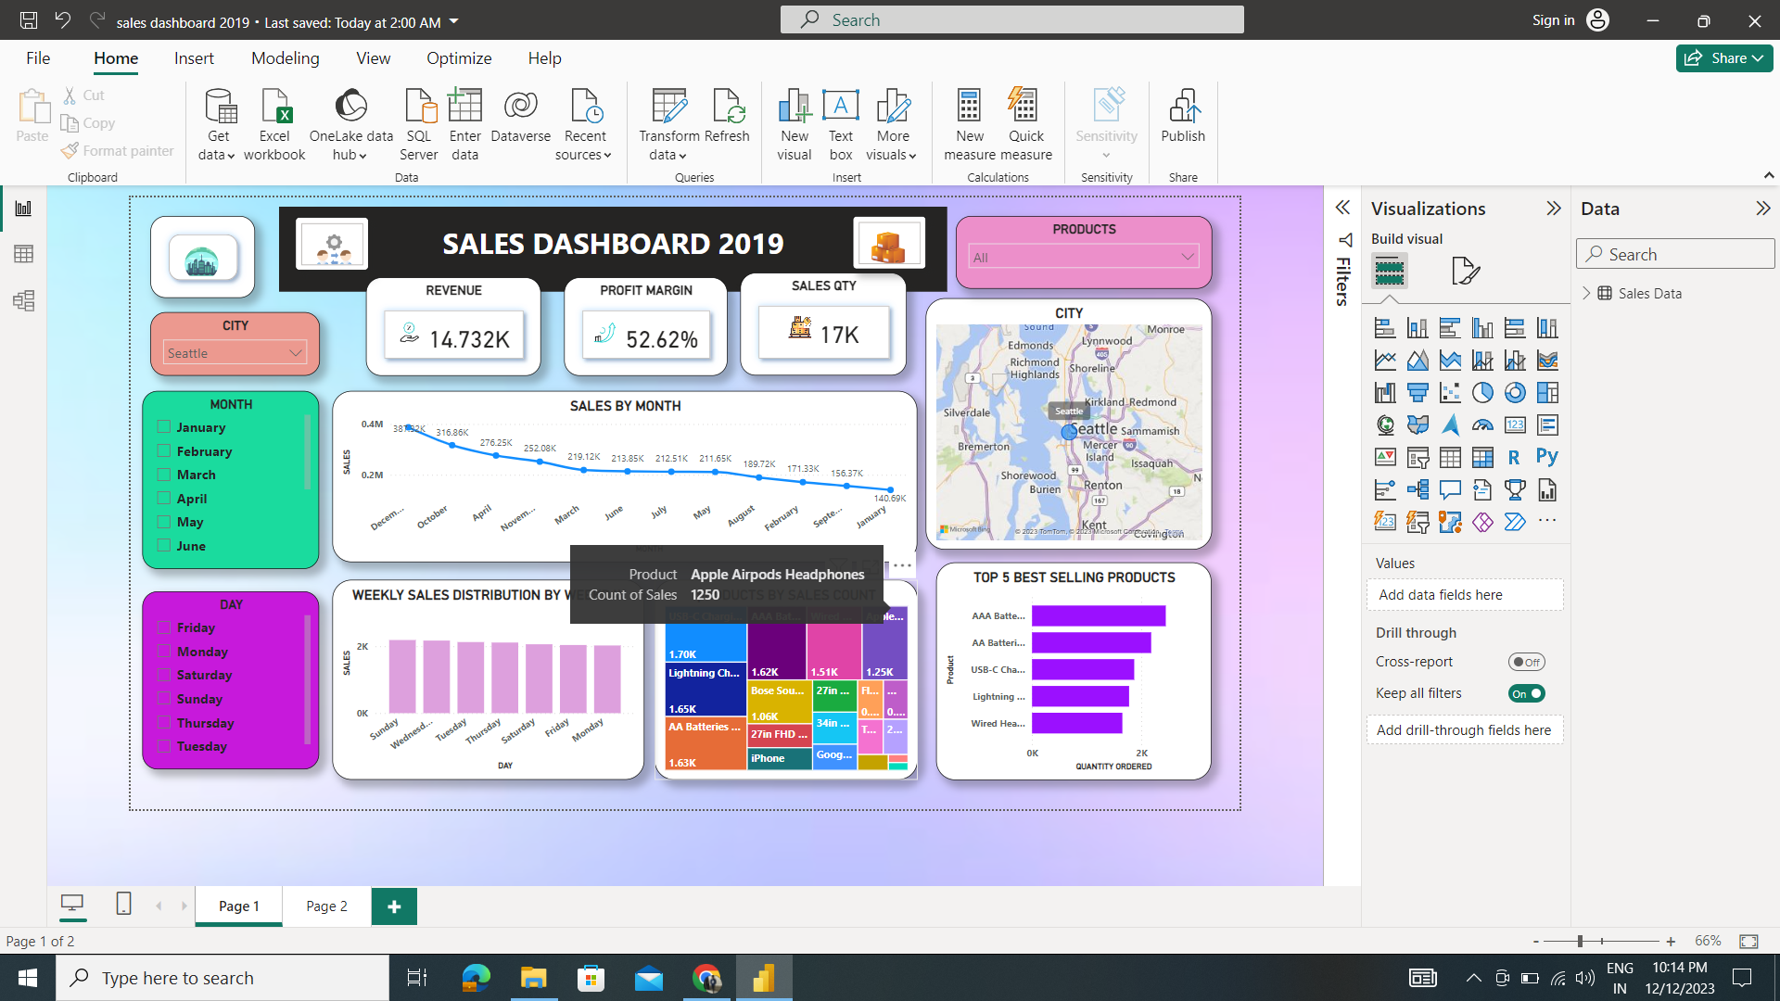
Dashboard of Seattle city

Slide 60
Conclusion :
In this project, I dive into a large sales dataset to extract valuable insights. I explored sales trends over time, identified the best-selling products, calculated revenue metrics such as total sales and profit margins, and created visualizations to present the findings effectively.
The sanfransico city has highest revenue, sales quantity and profit Margin when compared to other cites in the united sates of America in year 2019.
Revenue is 44.732k
Profit margin is 61.41k
Sales quanity is 50K
The Top 5 itemes sales in sanfrancisco are :
AAA Battries (4-pack)
AA Battries (4-pack)
USB-C charging cable
Lightening charging cable
Wired headphnes

Slide 61
THANK YOU !

